Slide 1
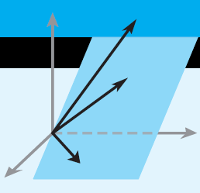
Elementary Linear Algebra
Howard Anton
Copyright © 2014 by John Wiley & Sons, Inc.
All rights reserved.
Chapter 2

Slide 2
Chapter 2
Determinants
2.1 Determinants by Cofactor Expansion
2.2 Evaluating Determinants by Row Reduction
2.3 Properties of Determinants;
Cramer’s Rule

Slide 3
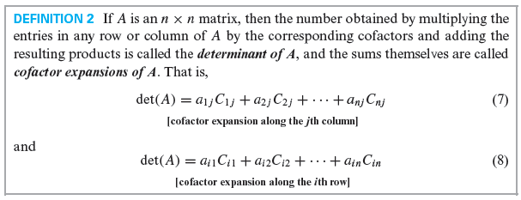
Section 2.1 Determinants by Cofactor Expansion

Slide 4
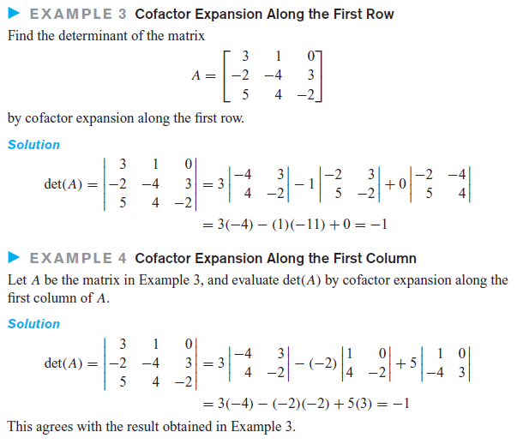

Slide 5
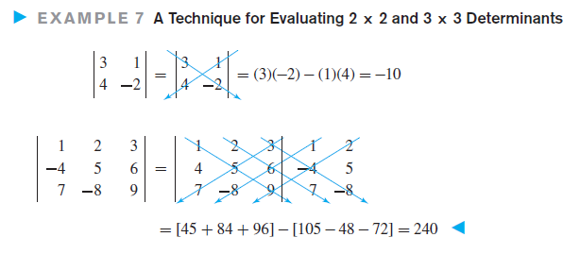
A technique for determinants of 2x2 and 3x3 matrices only

Slide 6
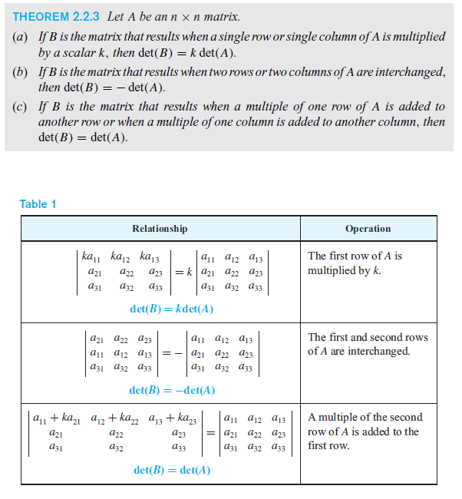
Row Reduction and Determinants

Slide 7
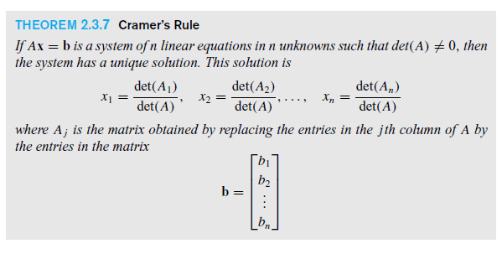
Section 2.3
Cramer’s Rule

Slide 8
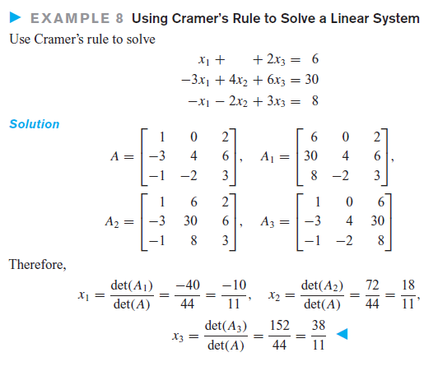
Section 2.3
Cramer’s Rule

